Slide 1
Amazon Product Insights Dashboard
Task 3 – Interactive Dashboard | Power BI
Data Analyst Internship – Elevate Labs
PRESENTED BY :
SWADHA ARYA

Slide 2
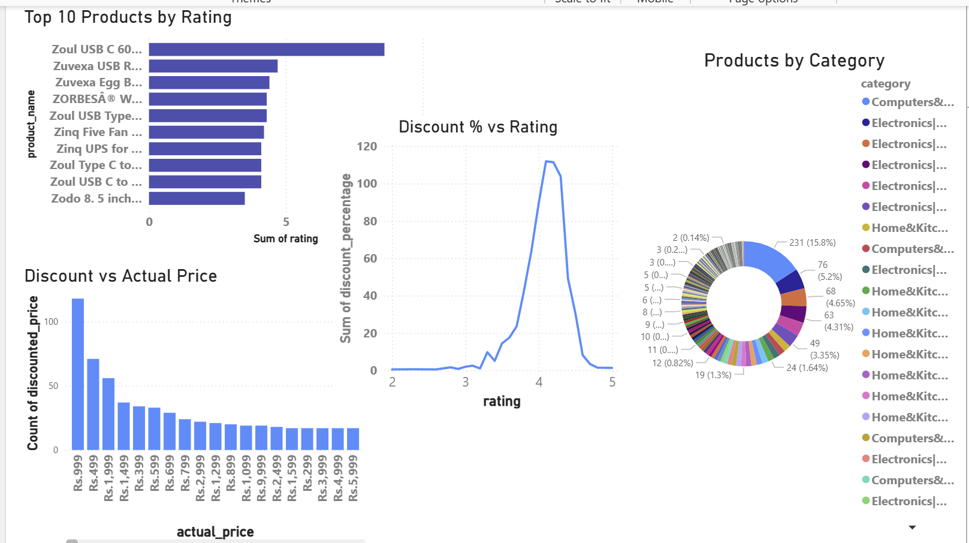
Interactive Dashboard – Amazon Product Dataset

Slide 3
Key Metrics and Visuals
🛍️ Total Products: ~100+
⭐ Average Rating: ~4.1
🎯 Average Discount: ~53%
🧑‍💼 User Reviews Tracked: 200K+
📈 Visuals Included:
- Top 10 Products by Rating
- Discount % vs Rating Line Chart
- Actual Price vs Discounted Price Count
- Product Category Distribution (Donut Chart)

Slide 4
Business Insights
High discounts do not always guarantee high ratings. Most high-rated products had 40–60% discount range.
Rs. 999 and Rs. 1499 are the most common price points — indicating possible pricing sweet spots.
A few product categories dominate (e.g., 'Computers & Accessories') — suggesting demand trends.
Zoul and Zuvexa brands appear most frequently in top-rated products — ideal for promotional focus.
Product diversity is high, but many fall under repeat pricing and rating clusters.
Stakeholders can interactively filter data using a combined slicer across Category, Rating, and Discounted Price, allowing for focused product or pricing analysis.

